Slide 1
HBP Info-Session
PRESENTED BY
Sergio Klecker
25th January 2024

Slide 2
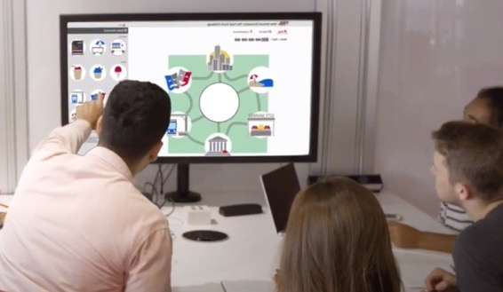
HBP - Providing lifelong learning from student to business leader
Higher Education
for higher education institutions
Corporate Learning
for corporations
Harvard Business Review
for individual managers

Slide 3
Our Philosophy
Participant-Centered Learning
A teaching practice that stimulates students’ thinking and prepares them for future managerial decision making, including how to articulate thoughts under pressure and craft supporting arguments.

Slide 4
We are your largest source of non-textbook material for business education
4
© 2020 Harvard Business School Publishing. All rights reserved. Harvard Business Publishing is an affiliate of Harvard Business School.

Slide 5
Our goal is to help educators deliver memorable learning experiences that develop leaders for a changing world
5
© 2020 Harvard Business School Publishing. All rights reserved. Harvard Business Publishing is an affiliate of Harvard Business School.

Slide 6
1st step: Register as Educator
The Educator account available for Faculty, allows professors to:
Explore the whole pedagogical content of the platform (>63,000 individual items)
Download the Educator copies of cases, articles (HBR!), books/chapters, videos
Access and download Teaching Notes linked to many of our materials
Preview online courses like Harvard Manage Mentor, and many others
Access all simulations and enjoy a free-trial (“run simulation as student”)
Get practical teaching advice and inspiration from experts (Teaching Center)
Get notifications and enroll in top Webinars and Seminars (Teaching Center)

Slide 7
>63,000 Course
materials
29,000 Cases
24,000 Business Articles
2,500 Industry/ Background Notes
260 Videos
100 Simulations
20,000
HBR Articles
44 Harvard Manage Mentor (HMM)

Slide 8
62 Global Partner Collections
Showcasing business cultures from around the world.
As of August 2022

Slide 9
Partner Collections Include
ABCC at Nanyang Tech University
Babson College
Berrett-Koehler Publishers
Business Enterprise Trust
Business Experts Press
Business Horizons
California Management Review
CEIBS (China Europe International Business School)
China Europe International Business School
CLADEA-BALAS
Columbia Business School
Crimson Group
Darden School of Business
Design Mgmt. Institute
European School of Mgmt.
Global Health Delivery / Harvard Medical School
Greif Center for Entrep. Studies – USC
HEC Montréal
Hong Kong University
Hubro Education
IE Business School
IESE Business School, University
IESE-Insight Magazine
IIM Ahmedabad
LiveCase
London Business School
Marketplace Simulations
McGraw-Hill
MEGA Learning
MIT Sloan Mgmt. Review
MobLab
NACRA Case Research Journal
Perseus Books
Princeton University Press
Program on Negotiation at Harvard Law
Public Education Leadership Project
Rotman Mgmt. Magazine
Rotterdam School of Mgmt.
SimCase
Singapore Management University
Social Enterprise Knowledge Network
Stanford Graduate School of Business
The Crimson Group
Thunderbird School of Global Mgmt.
Tsinghua SEM
UC Berkeley – Haas School of Business
University of Hong Kong
USC Marshall School of Business
WDI Publishing at the U. of Michigan
Wharton School, U. of Pennsylvania

Slide 10
Translations: Cases, Articles, and More
5,000 Spanish
3,000 Japanese
3,400 Chinese
1,700 Portuguese
900 French
800 German
300 Arabic
As of August 2022

Slide 11
Cases
Over 11,000 Case Studies from Harvard Business School
Podcases: personal stories of real business leaders, delivered through audio
Multimedia Cases: bring text to life with video, animation, audio
HBS Brief Cases: 5-8 pages (all with Teaching Note)
Harvard Business Review very short cases with expert commentary
Multimedia Cases

Slide 12
Articles
20,000+
Articles from Harvard Business Review
Bringing topical and provocative thinking to the classroom

Slide 13
Core Curriculum
Core Theories & Frameworks
Explains fundamental business concepts
HBS authored—pedagogical link between Readings and HBS cases
Videos and Interactive Illustrations help students master complex theories
Comes with Teaching Notes, review questions, exhibit slides, and glossary of terms
Test Banks accompany many readings
Disciplines:
Entrepreneurship
Finance
Financial Accounting
Marketing
Operations Management
Organizational Behavior
Strategy

Slide 14
Core Curriculum (example):
Marketing
Framework for Marketing Strategy Formation
Marketing Intelligence
Creating Customer Value
Customer Centricity
Customer Management
Consumer Behavior and the Buying Process
Business-to-Business Marketing
Global Marketing
Segmentation and Targeting
Brand Positioning
Brands and Brand Equity
Competitive Strategies
Product Policy
Pricing Strategy
Developing and Managing Channels of Distribution
Sales Force Design and Management
Digital Marketing
Marketing Communications

Slide 15
Simulations
Simulate the real-world & encourage new skill development
Seat times range from 30 minutes to multi-hour
Simple, powerful administration tools
Flexible setup options
Detailed Teaching Notes
Web-based, graphical results ready for class presentation
Video: The Power of Using Simulation in the Classroom

Slide 16
Simulation Topics Include:
Adaptive Leadership
Balanced Scorecard
Capital Budgeting
Career Planning
Change Management
Crossing the Chasm
Decision Making
Design Thinking
Digital Strategy
Economics
Family Business
Financial Analysis
Global Collaboration
Innovation
Introductory Finance
Inventory Management
IT Management
Lean Start-Up
M&A
Marketing Strategy
Negotiation
Networking
Operations Management
Organizational Design
Positioning
Porter’s Five Forces
Pricing
Project Management
Service Management
Startups
Strategic Data Analytics
Strategy and the Value Chain
Supply Chain Management
Sustainability Management
Value Proposition
Working Capital

Slide 17
Resources for Educators Teaching with Simulations
Articles on preparing, managing, and debriefing simulations
Detailed Teaching Notes
Author videos
Faculty Advisor Program: Hear from others who taught the simulation
Demonstration session
24/7 customer service support

Slide 18
Harvard ManageMentor®
for students
Creating career-ready professionals with the skills needed to thrive in the modern workforce.

Slide 19
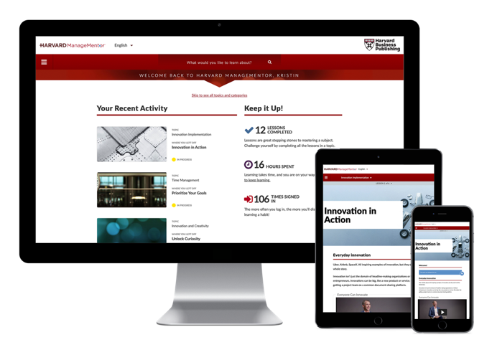
Harvard ManageMentor®
Watch Video
Self-Paced Learning
44 modules spread across all major disciplines
Asynchronous interactive modules
Organized into 3-5 lessons
Learn directly from experts
Approx. 2 hours to complete each
Reports to track student's progress
Learn-Practice-Reflect
Each lesson includes cycle of practice
and reflection to reinforce learning

Slide 20
Harvard ManageMentor®
A Variety of Topics - 44 different modules
Leading Yourself
Career Management Ethics at Work Presentation Skills Sharpening Your Business Acumen Stress Management Time Management Writing Skills
Leading Others
Coaching Developing Employees Difficult Interactions Diversity, Inclusion, and Belonging Feedback Essentials Global Collaboration Hiring Leading People Leveraging Your Networks Managing Your Boss Meeting Management Performance Appraisal Persuading Others Retaining Employees Team Creation Team Management
Leading The Business
Attracting and Cultivating Talent* Budgeting Business Case Development Business Plan Development Change Management Crisis Management Customer Focus Decision Making Delegating Digital Intelligence Finance Essentials Goal Setting Innovation and Creativity Innovation Implementation Marketing Essentials Negotiating Performance Measurement
Process Improvement Project Management Sharpening Your Business Acumen* Strategic Thinking Strategy Planning and Execution
*New

Slide 21
Harvard ManageMentor®
Curated Collections of Topics
Business Fundamentals
Provide non-business majors an introduction to core business skills.
Finance Essentials
Business Case Development
Marketing Essentials
Performance Measurement
Negotiating
Customer Focus
Early Career Readiness
Relieve students’ first job jitters with an introduction to essential soft-skills to ease their transition into the workforce.
Diversity
Goal Setting
Innovation & Creativity
Leveraging Your Networks
Presentation Skills
Feedback Essentials
Managing Yourself
Help students discover their talents, explore career options, and manage them-selves as they navigate post-graduation life.
Career Management
Decision Making
Difficult Interactions
Persuading Others
Stress Management
Time Management
Leadership
Hone students’ leadership skillset as they prepare to enter management roles.
Leading People
Delegating
Change Management
Coaching
Team Management
Strategic Thinking

Slide 22
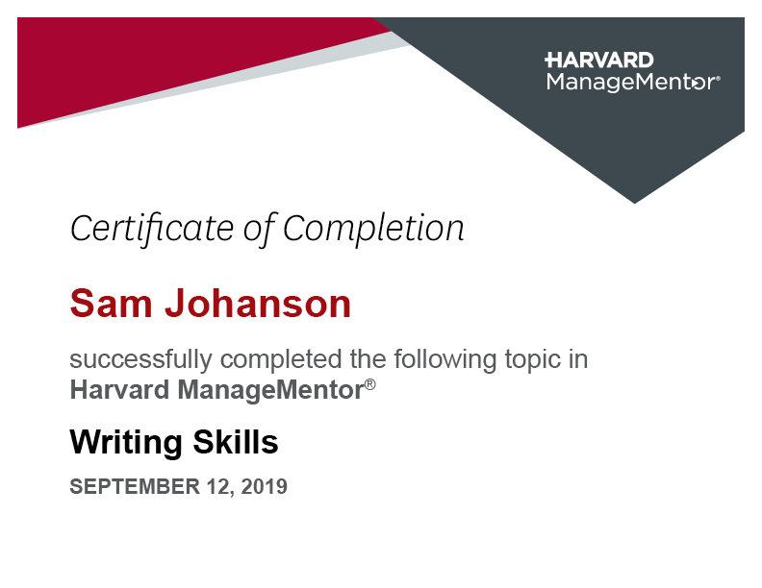
Harvard ManageMentor®
Students earn personalized certificates and digital badges from Harvard ManageMentor to build their resumes and share achievements on social media

Slide 23
Online Courses
Comprehensive Topic Introductions
Used in undergraduate courses, or for MBA pre-matriculation work
Use complete course or selected sections
Certificates of completion
Randomized exam questions
Current Online Courses:
Finance
Financial Accounting
Management Communication
Mathematics for Management
Quantitative Methods
Spreadsheet Modeling

Slide 24
Challenge: Finding the Right Course Materials
Course Explorer
Easily find ideal material and new ideas for your courses.

Slide 25
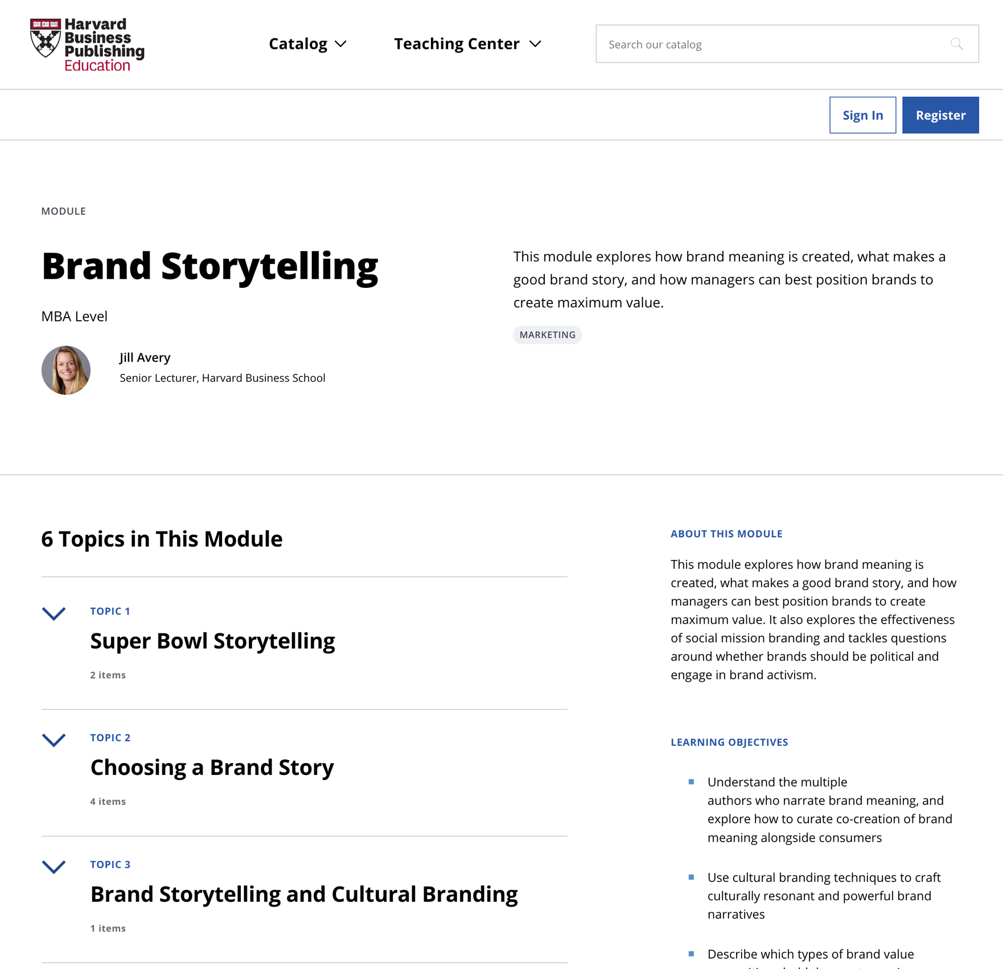
Finding the Right Course Materials
Course Explorer
Browse courses, assignments, and pedagogical guidance.
Discover new ideas and content for your courses. Browse our library of course materials, assignments, and pedagogical guidance—curated by our editors, partners, and faculty from leading business schools.
Visit Course Explorer

Slide 26
Course Explorer
Finding the Right Course Materials
Accounting
Business and Government Relations
Business Ethics
Companies
Digital Transformation
Diversity, Equity, and Inclusion
Economics
Entrepreneurship
Finance
General Management
Health Care
Human Resource Management
Information Technology
Innovation
International Business
Leadership
Marketing
Negotiation
Operations Management
Organizational Behavior
Simulations
Social Enterprise
Strategy
Sustainability
Teaching and the Case Method
Undergraduate

Slide 27
What’s the difference between a Collection, a Module, and a Course?
Collections are lists of learning materials and resources focused on a specific topic or theme.
Modules are units of sequenced topics; they’re a way to organize content within a course. Each module contains resources that, when used together, can achieve specific learning objectives.
Courses are made up of sequenced modules. They represent a full set of course materials; think of them almost like a syllabus.

Slide 28
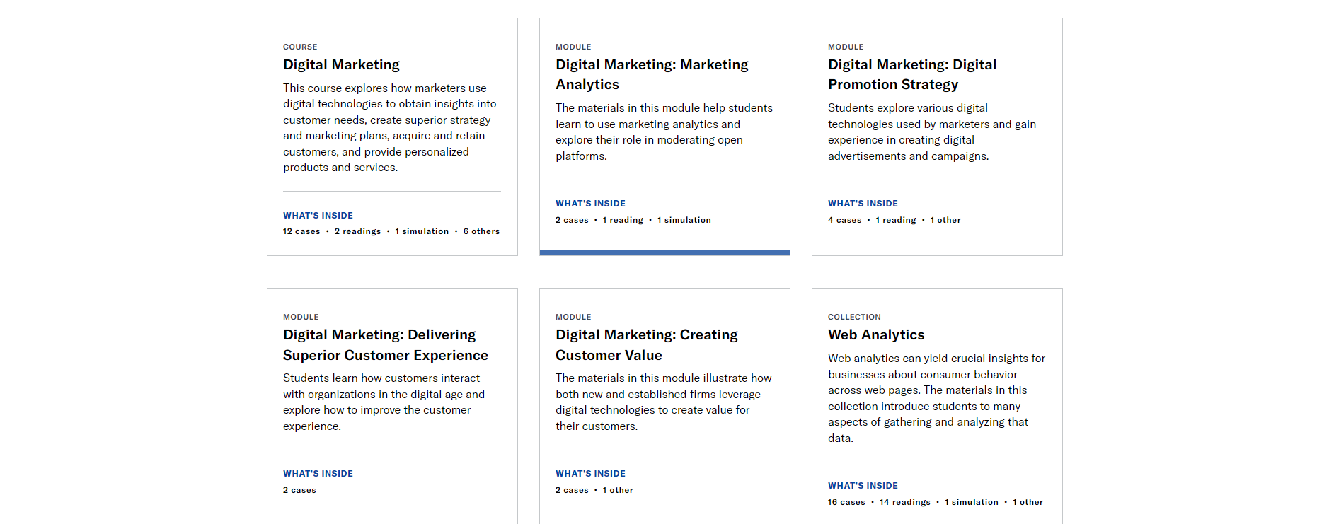
Course Explorer
Finding the Right Course Materials
Digital Transformation example

Slide 29
Thought Leadership Resources for Educators
Webinars: Hear real-time advice from experts Click here
Seminars: Attend in-depth educator training Click here
Guides: Explore our guides that address specific topics of interest in teaching business topics online Click here
Inspiring Minds: Get practical teaching advice and inspiration from best in class Click here
Faculty Lounge: Our weekly newsletter which serves as an unfiltered space for educators to explore ideas important to their work. Click here

Slide 30
For technical support, please contact techhelp@hbsp.harvard.edu or custserv@hbsp.harvard.edu
or use the live chat available on the platform (“Ayuda”)
Customer Service & Technical Support Available 24/7

